Slide 1
SM Foundation Incorporated Scholarship System Module 2: Existing Scholars
Team Member | Role
Caram, Fermin IV | Project Manager
Oncinian, Jose Louise | Database Administrator
Baclaya, Joreen | Software Engineer
Frias, Levi | Infrastructure Engineer

Slide 2
Project Objectives
To provide SM Foundation Incorporated with a web-based system that would allow the Foundation to track, update, and review its scholars’ records.
To help increase SM Foundation Incorporated’s efficiency by implementing customizable report generation in the system.
To be able to reduce turnaround times through automatic calendar-based email notifications.

Slide 3
Purpose
The project was initiated with the primary purpose of developing a web-based system capable of consolidating SM Foundation Incorporated’s various scholar-related records and automating several of its business processes.

Slide 4
Target Users
SM Foundation
SM Scholars

Slide 5
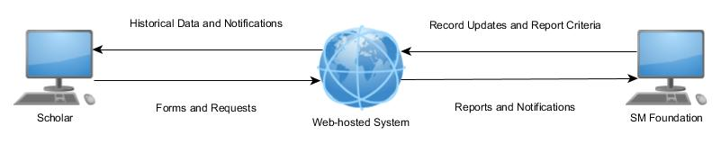
Systems Configuration Diagram

Slide 6
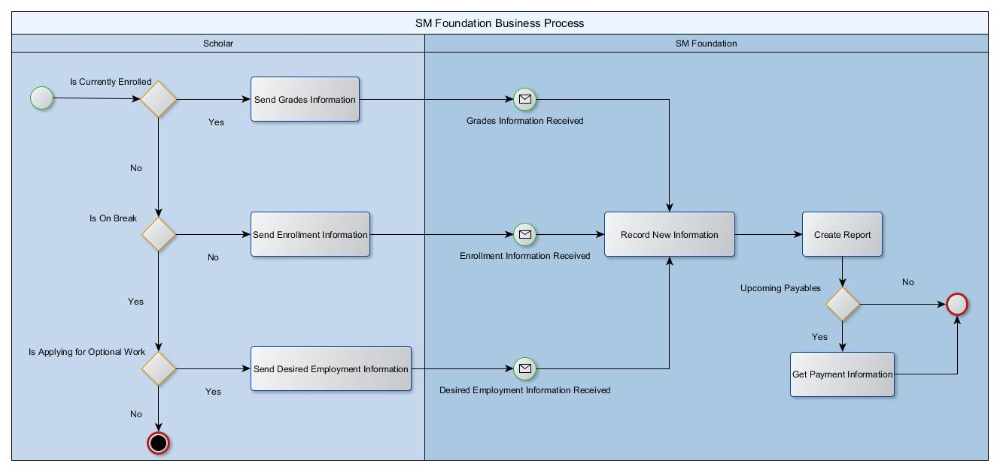
Business Process Diagram

Slide 7
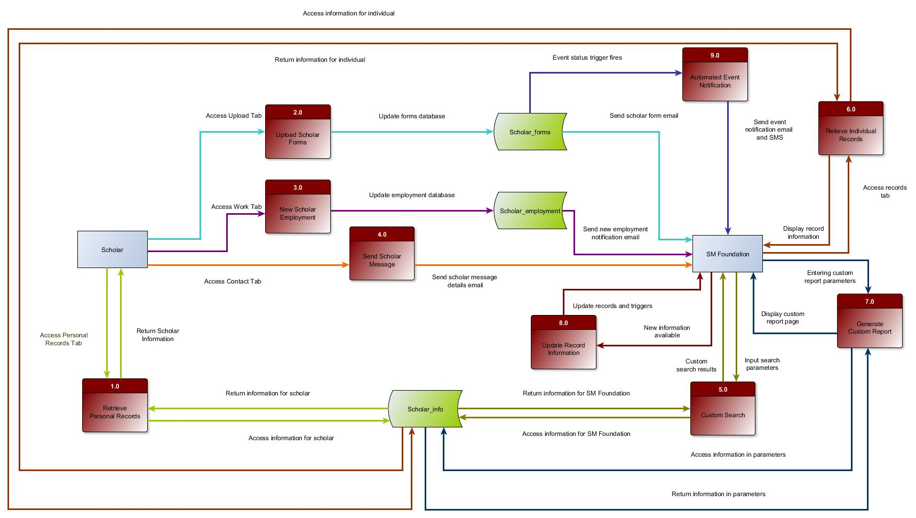
Context Level Diagram (DFD Level 0)

Slide 8
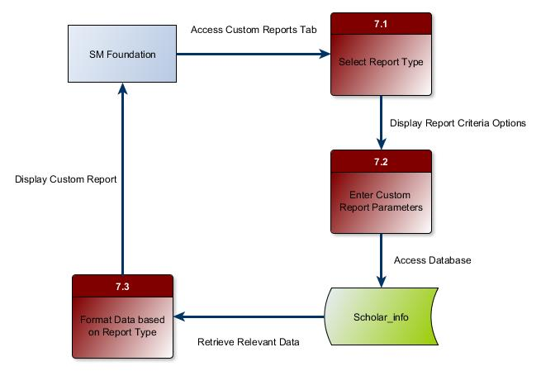
Data Flow Diagram (DFD Level 1)

Slide 9
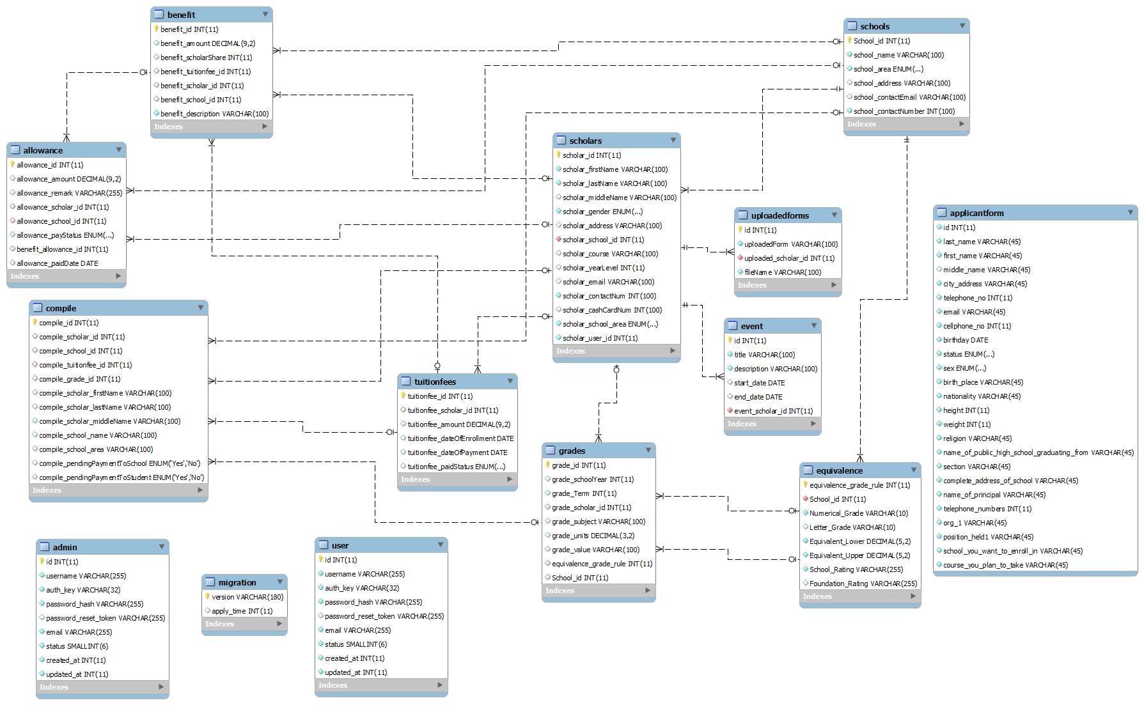
Entity Relationship Diagram

Slide 10
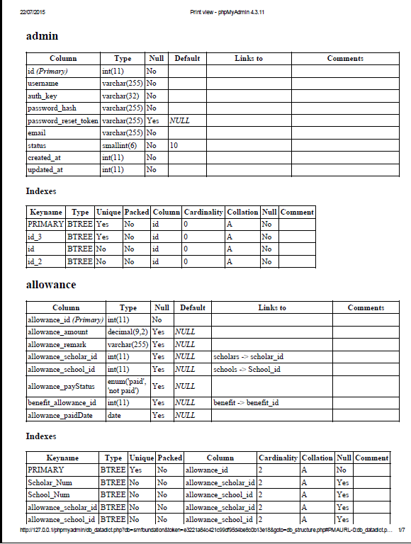
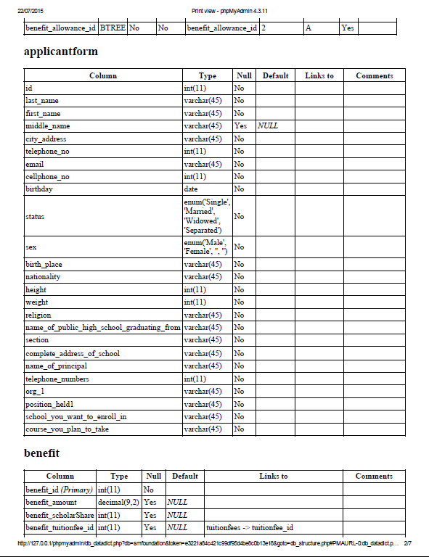
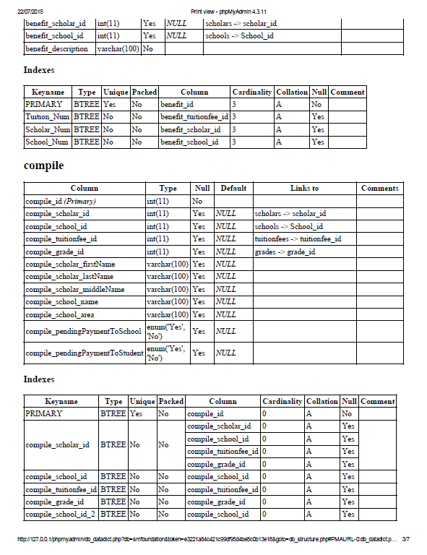
Data Dictionary

Slide 11
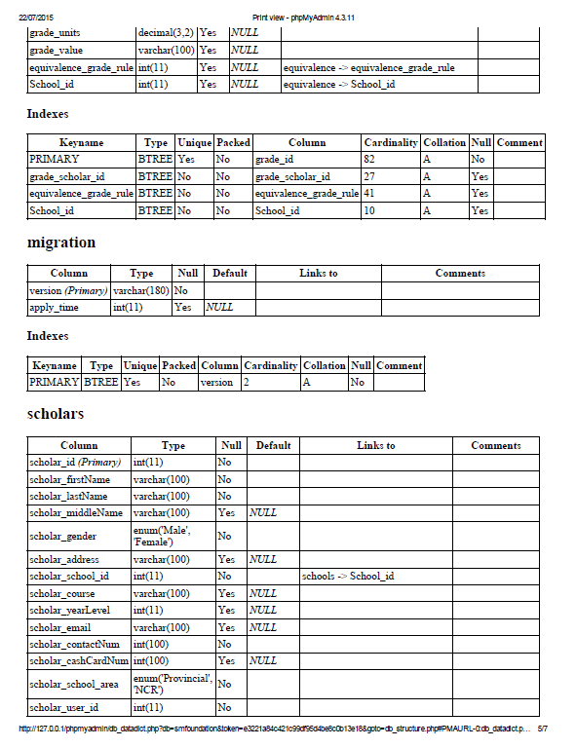
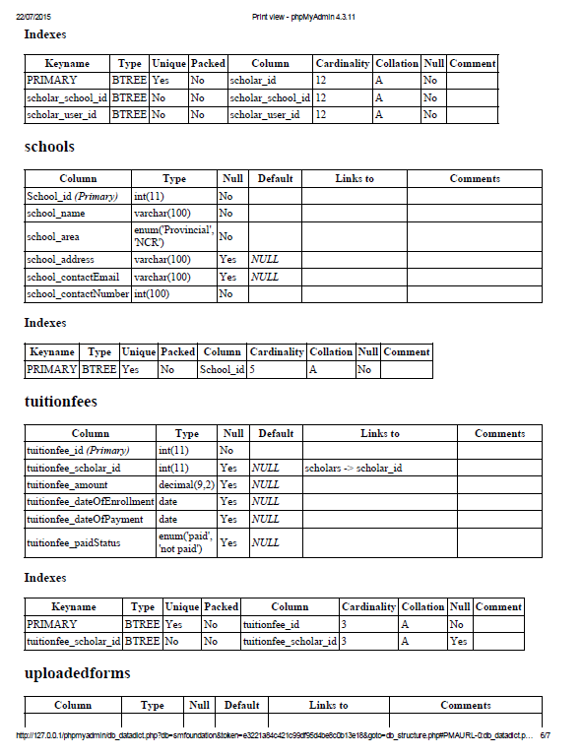
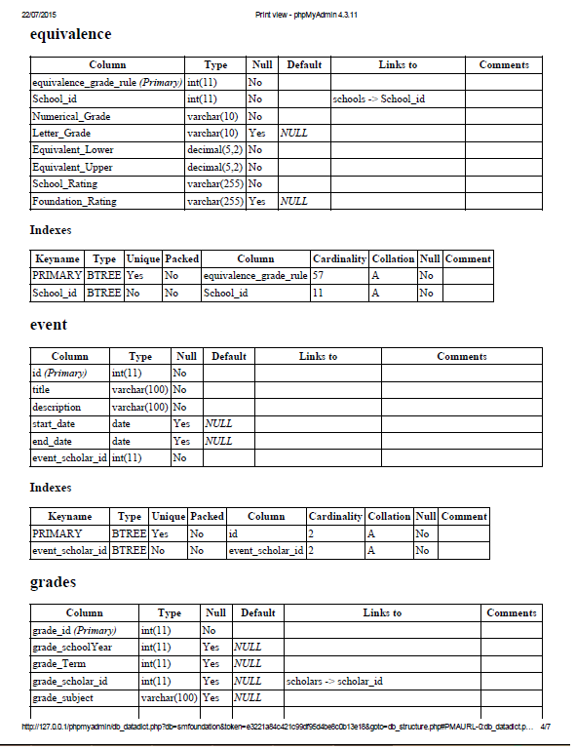
Data Dictionary

Slide 12
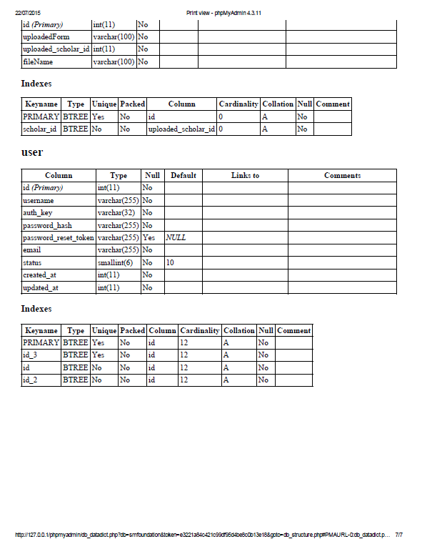
Data Dictionary

Slide 13
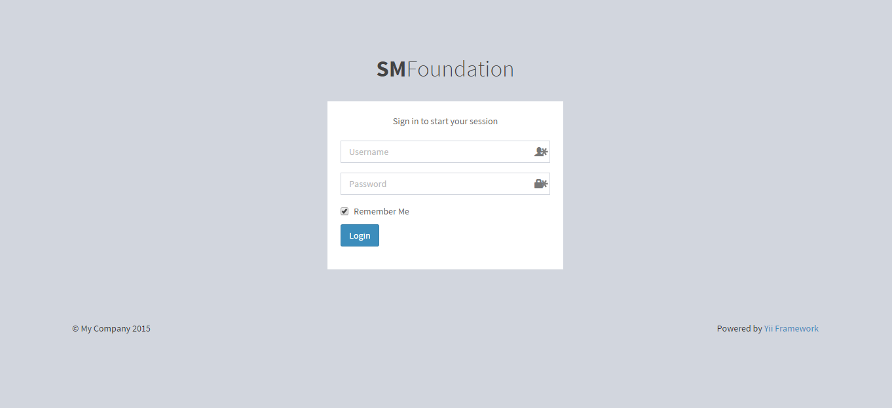
Screenshots
Scholar Log-In

Slide 14
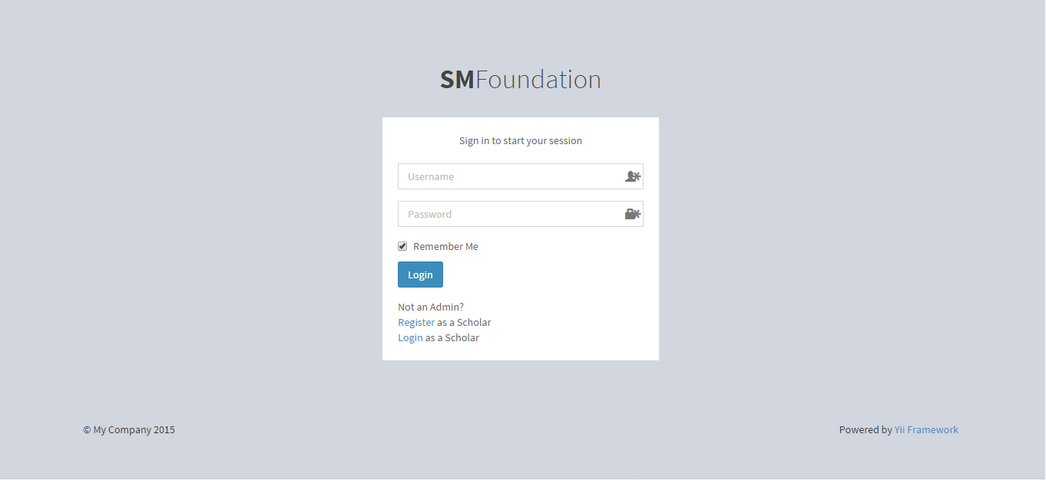
Screenshots
SM Foundation (Admin) Log-In

Slide 15
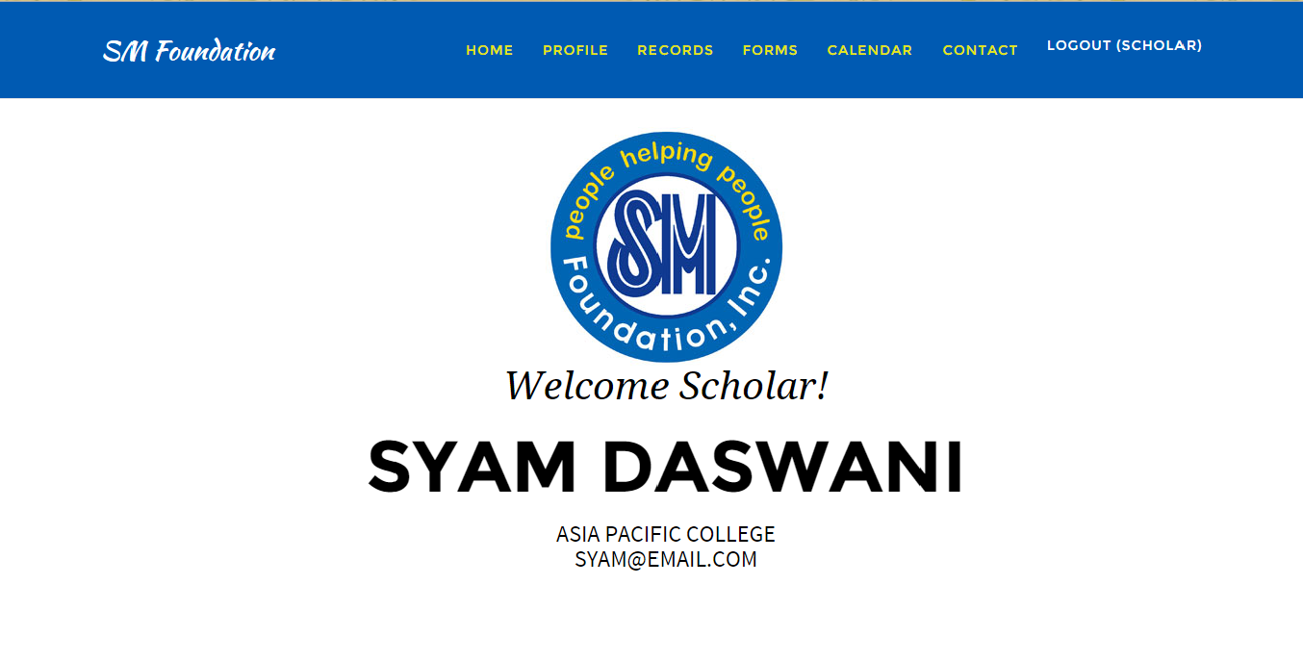
Screenshots
Scholar Home

Slide 16
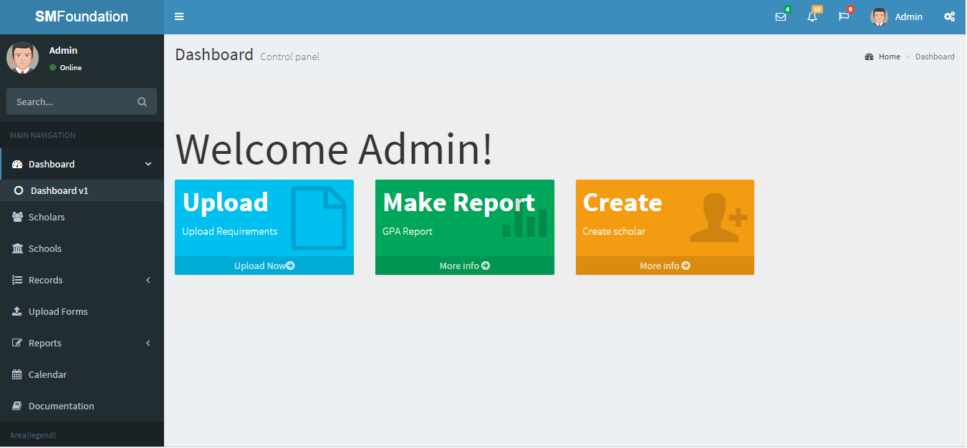
Screenshots
Admin Home

Slide 17
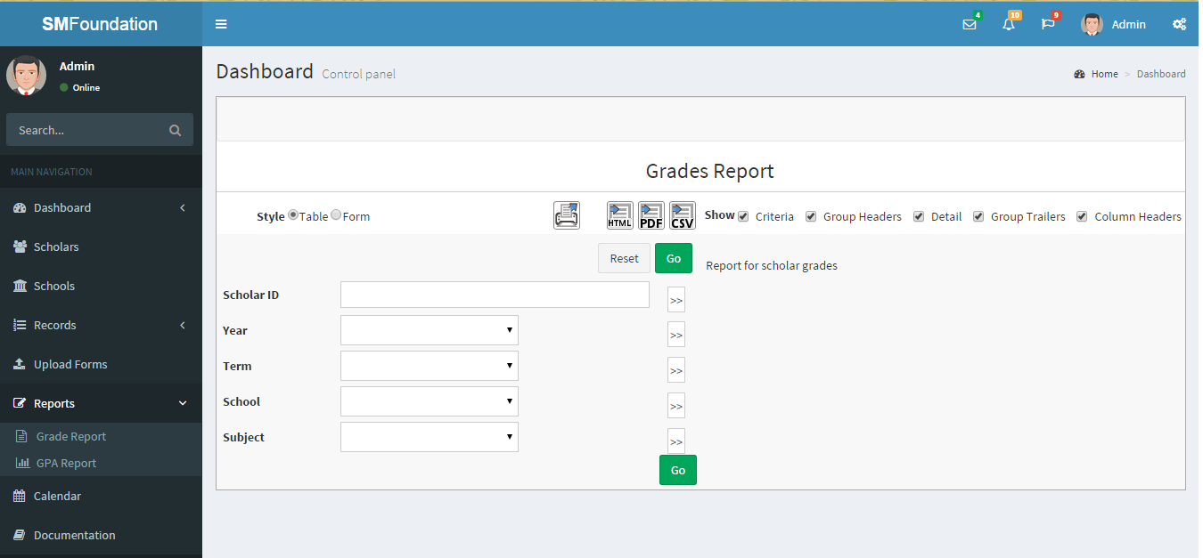
Screenshots
Grades Report

